Slide 1

The National University of Computer and Emerging Sciences
Decision Trees
Machine Learning for Data Science
Dr. Akhtar Jamil
Department of Computer Science

Slide 2
Goals
Today’s Lecture
Decision Trees

Slide 3
Motivation
Problem: Given the following information of a customer, decide whether the bank should assign a loan or not
Classes: Safe or Risky
Features: Credit History, Income, Term, Personal Info
Credit | Term | Income | y
excellent | 3 yrs | high | safe
fair | 5 yrs | low | risky
fair | 3 yrs | high | safe
poor | 5 yrs | high | risky
excellent | 3 yrs | low | risky
fair | 5 yrs | low | safe
poor | 3 yrs | high | risky
poor | 5 yrs | low | safe
fair | 3 yrs | high | safe

Slide 4





Motivation
ŷ_{i} = +1
Loan Application
Classifier MODEL
Safe
Risky
Output: ŷ Predicted class
Input: x
i
ŷ_{i} = -1

Slide 5
Motivation
x_{i} = (Credit History = poor, Income = high, Term = 5 years)
Start
excellent
poor
Credit?
fair
Safe
Term?
Income?
high
Low
3 years
5 years
Risky
Safe
Term?
Risky
3 years
5 years
Risky
Safe

Slide 6
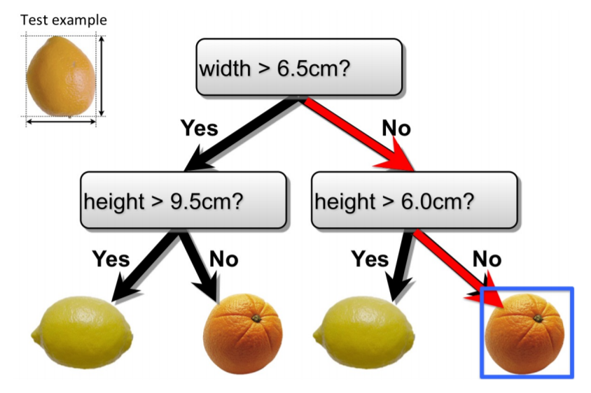
Motivation

Slide 7
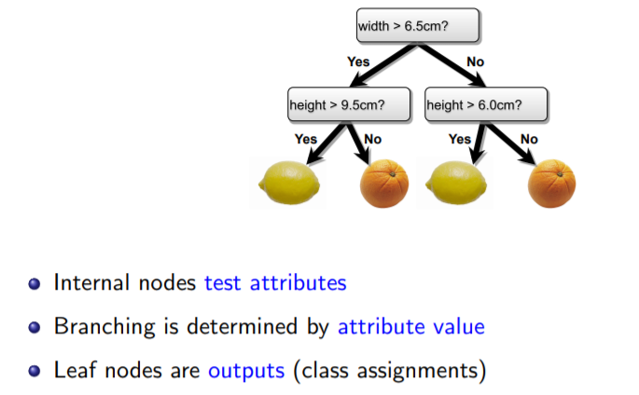
Motivation

Slide 8
Decision Trees
Decision tree (DT) is a machine learning algorithm.
Its learning function is represented by a decision tree.
DT can also be represented as sets of if-then rules.
Among the most popular of inductive inference algorithms
Applied to a broad range of tasks:
Medical diagnosis
Credit risk analysis
Object classification

Slide 9
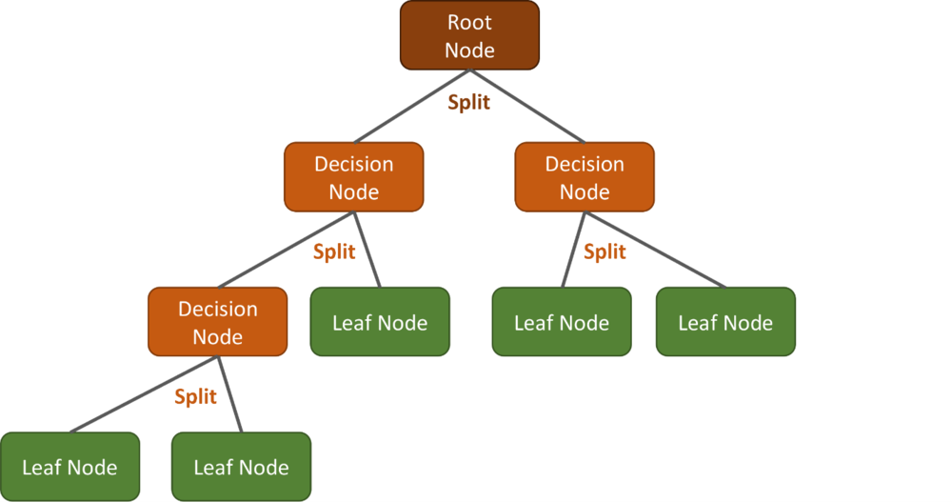
Decision Trees

Slide 10
Classification and Regression Trees (CART)
How do we organize the tree to produce the lowest classification error?
Any decision tree will successively split the data into smaller and smaller subsets.
It would be ideal if all the samples associated with a leaf node were from the same class.
Such a subset, or node, is considered pure in this case.
A generic tree-growing methodology, known as CART, successively splits nodes until they are pure.
Classification and Regression Tree

Slide 11
Classification and Regression Trees (CART)
Six key questions:
Should the questions be binary (e.g., is gender male or female) or numeric (e.g., is height >= 5’4”) or multi-valued (e.g., race)?
Which feature should be tested at each node?
When should a node be declared a leaf?
If the tree becomes too large, how can it be pruned?
If the leaf node is impure, what category should be assigned to it?
How should missing data be handled?

Slide 12









Decision tree learning problem
Training data: N observations (x_{i},y_{i})
Credit | Term | Income | y
excellent | 3 yrs | high | safe
fair | 5 yrs | low | risky
fair | 3 yrs | high | safe
poor | 5 yrs | high | risky
excellent | 3 yrs | low | risky
fair | 5 yrs | low | safe
poor | 3 yrs | high | risky
poor | 5 yrs | low | safe
fair | 3 yrs | high | safe
Optimize quality metric on training data
T(X)

Slide 13
Decision Trees
Use a decision tree to predict categories for new events.
Use training data to build the decision tree.
New
Events
Training
Events and
Categories
Decision
Tree
Category

Slide 14
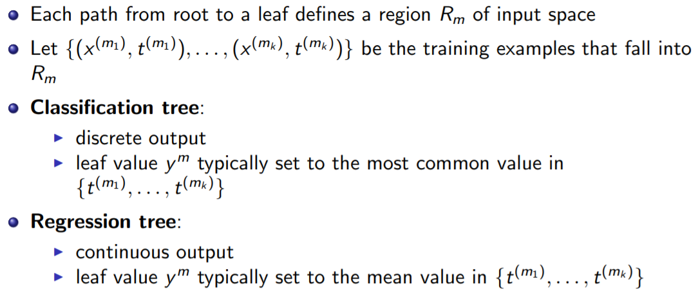
Classification and Regression

Slide 15
Decision Tree Representation
Outlook
Sunny
Overcast
Rain
Humidity
Each internal node tests an attribute
High
Normal
Each branch corresponds to an
attribute value node
No
Yes
Each leaf node assigns a classification

Slide 16
Decision Tree Algorithm
The basic algorithm of decision tree employees top-down and greedy search
The main algorithm that we will discuss is ID3 developed by Ross Quinlan (1986)

Slide 17
ID3 Algorithm
Iterative Dichotomiser
A ← select the “best” decision attribute to split the examples
For each value of A create new child nodes
Split training examples according to the attribute value (Sunny, Overcast, Rain)
If all training examples are perfectly classified stop, else iterate over new leaf nodes.

Slide 18
Quality metric: Classification error
Error measures fraction of mistakes
Error = # incorrect predictions
# examples
Best possible value : 0.0
Worst possible value: 1.0

Slide 19






















































How do we find the best tree?
Exponentially large number of possible trees makes decision tree learning hard!
Learning the smallest decision tree is an NP-hard problem [Hyafil & Rivest ’76]
T₁(X)
T₂(X)
T₃(X)
T₄(X)
T₅(X)
T₆(X)

Slide 20
Our training data table
Assume N = 40, 3 features
Credit | Term | Income | y
excellent | 3 yrs | high | safe
fair | 5 yrs | low | risky
fair | 3 yrs | high | safe
poor | 5 yrs | high | risky
excellent | 3 yrs | low | risky
fair | 5 yrs | low | safe
poor | 3 yrs | high | risky
poor | 5 yrs | low | safe
fair | 3 yrs | high | safe
Greedy decision tree learning

Slide 21
Start with all the data
Loan status:
Safe Risky
(all data)
22 ₁₈
# of Risky loans
# of Safe loans
N = 40 examples

Slide 22
Compact visual notation: Root node
Loan status:
Safe Risky
Root
22 18
# of Risky loans
# of Safe loans
N = 40 examples

Slide 23
Decision stump: Single level tree
Loan status:
Safe Risky
Root
22 18
Split on Credit
Credit?
excellent 9 0
fair 9 4
poor 4 14
Subset of data with Credit = excellent
Subset of data with Credit = fair
Subset of data with Credit = poor

Slide 24
Visual notation: Intermediate nodes
Loan status:
Safe Risky
Root
22 18
Credit?
excellent 9 0
fair 9 4
poor 4 14
Intermediate nodes

Slide 25




Making predictions with a decision
Loan status:
Safe Risky
root
22 18
credit?
For each intermediate node, set ŷ = majority value
excellent 9 0
fair 9 4
poor
4 14
Safe
Safe
Risky

Slide 26
Selecting best feature to split on

Slide 27
How do we learn a decision stump?
Loan status:
Safe Risky
Root
22 18
Find the “best” feature to split on!
Credit?
excellent 9 0
fair 9 4
poor 4 14

Slide 28


How do we select the best feature?
Choice 1: Split on Credit
Choice 2: Split on Term
Loan status:
Safe Risky
Root
Loan status:
Safe Risky
Root
22 18
22 18
OR
Credit?
Term?
excellent 9 0
fair 9 4
poor
3 years
16 4
5 years
4 14
6 14

Slide 29
How do we measure effectiveness of a split?
Loan status:
Safe Risky
Root
22 18
Idea: Calculate classification error of this decision stump
Credit?
Error = # mistakes
# data points
excellent 9 0
fair 9 4
poor
4 14

Slide 30




Calculating classification error
Step 1: ŷ = class of majority of data in node
Step 2: Calculate classification error of predicting ŷ for this data
Loan status:
Safe Risky
Root 22 18
Error = .
=
22 correct
18 mistakes
Safe
Tree | Classification error
(root) | 0.45
ŷ = majority class

Slide 31
Choice 1: Split on Credit history?
Choice 1: Split on Credit
Loan status:
Safe Risky
Root
Does a split on Credit reduce classification error below 0.45?
22 18
Credit?
excellent 9 0
fair 9 4
poor
4 14

Slide 32

Split on Credit: Classification error
Choice 1: Split on Credit
Loan status:
Safe Risky
Root
22 18
Error = .
=
Credit?
excellent 9 0
fair 9 4
poor
4 14
Tree | Classification error
(root) | 0.45
Split on credit | 0.2
Safe
Safe
Risky
0 mistakes
4 mistakes
4 mistakes

Slide 33



Choice 2: Split on Term?
Choice 2: Split on Term
Loan status: Root
Safe Risky 22 18
Term?
3 years
16 4
5 years
6 14
Safe
Risky

Slide 34
Evaluating the split on Term
Choice 2: Split on Term
Loan status: Root
Safe Risky 22 18
Error = .
=
Term?
3 years
16 4
5 years
6 14
Tree | Classification error
(root) | 0.45
Split on credit | 0.2
Split on term | 0.25
Safe
Risky
4 mistakes
6 mistakes

Slide 35


Choice 1 vs Choice 2: Comparing split on Credit vs Term
Tree | Classification error
(root) | 0.45
split on credit | 0.2
split on loan term | 0.25
Choice 1: Split on Credit
Choice 2: Split on Term
Loan status:
Safe Risky
Root
Loan status:
Safe Risky
Root
22 18
22 18
OR
Credit?
Term?
excellent
fair 8 4
poor
3 years
16 4
5 years
9 0
4 14
6 14
WINNER

Slide 36
Feature split selection algorithm
Given a subset of data M (a node in a tree)
For each feature h_{i}(x):
Split data of M according to feature h_{i}(x)
Compute classification error of split
Chose feature h*(x) with lowest classification error

Slide 37
Recursion & Stopping conditions

Slide 38
We’ve learned a decision, what next?
Loan status:
Safe Risky
Root
22 18
Credit?
excellent 9 0
fair
9 4
poor 4 14
Safe
All data points are Safe ➔
nothing else to do with this subset of data
Leaf node

Slide 39
Tree learning = Recursive learning
Loan status:
Safe Risky
Root
22 18
Credit?
excellent 9 0
fair
9 4
poor 4 14
Safe
Build decision stump with Build decision stump with
subset of data where Credit = fair
subset of data where Credit = poor

Slide 40
Second level
Loan status:
Safe Risky
Root
22 18
Credit?
excellent 9 0
poor 4 14
Income?
fair
9 4
Term?
Safe
3 years
0 4
5 years
9 0
high 4 5
Low 0 9
Risky
Safe
Risky
Build another stump these data points

Slide 41
Final decision tree
Loan status:
Safe Risky
Root
22 18
poor 4 14
Credit?
Income?
excellent 9 0
Fair
9 4
high 4 5
low 0 9
Safe
Term?
Term?
Risky
3 years
5 years
0 4
9 0
3 years
0 2
5 years
4 3
Risky
Safe
Risky
Safe

Slide 42
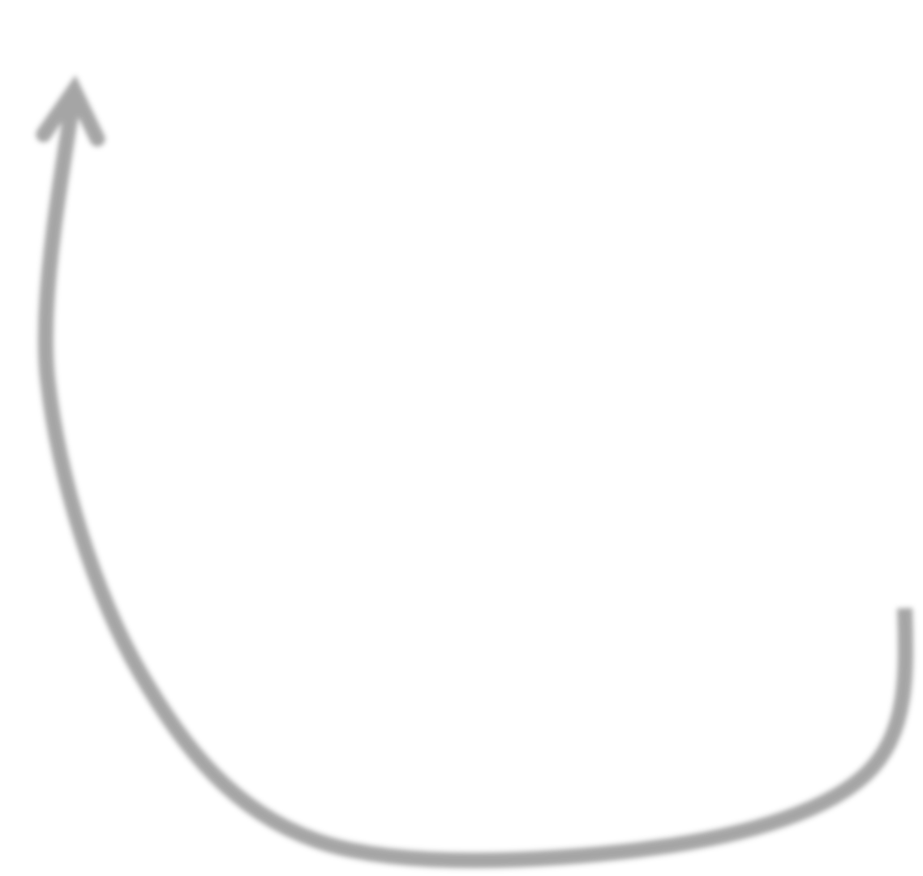
Simple greedy decision tree learning
Pick best feature to split on
Learn decision with this split
For each leaf of decision do recursion
When do we stop???
©2021 Carlos Guestrin

Slide 43
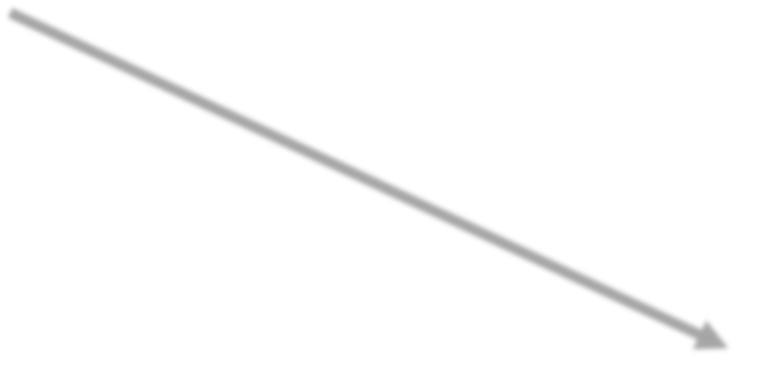









Stopping condition 1: All data agrees on y
All data in these nodes have same y value ➔ Nothing to do
Loan status:
Safe Risky
Root
22 18
poor 4 14
Credit?
Income?
excellent 9 0
excellent 9 0
Fair
high 4 5
low 0 9
9 4
low 0 9
Safe
Term?
Term?
Risky
3 years
5 years
3 years
0 4
5 years
9 0
0 4
9 0
3 years
0 2
5 years
4 3
3 years
0 2
Risky
Safe
Risky
Safe

Slide 44
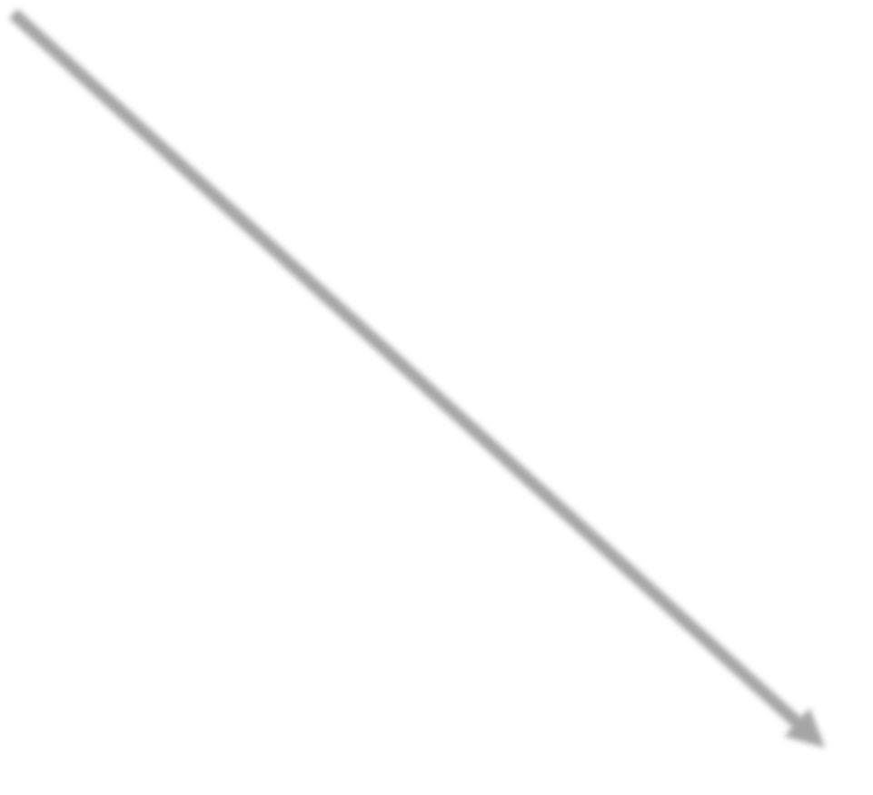

Stopping condition 2: Already split on all features
Already split on all possible features ➔ Nothing to do
Loan status:
Safe Risky
Root
22 18
poor 4 14
Credit?
Income?
excellent 9 0
Fair
9 4
high 4 5
low 0 9
Safe
Term?
Term?
Risky
3 years
5 years
0 4
9 0
3 years
0 2
5 years
4 3
5 years
4 3
Risky
Safe
Risky
Safe

Slide 45



Greedy decision tree learning
Step 1: Start with an empty tree
Step 2: Select a feature to split data
For each split of the tree:
Step 3: If nothing more to do, make predictions
Step 4: Otherwise, go to Step 2 & continue (recurse) on this split
Pick feature split leading to lowest classification error
Stopping conditions 1 & 2
Recursion

Slide 46
Is this a good idea?
Proposed stopping condition 3: Stop if no split reduces the classification error

Slide 47
References
Chapter 3, Machine Learning, Tom Mitchell
http://cs229.stanford.edu/notes2021spring

Slide 48
Thank You ☺

